Slide 1
ELECTRICAL
MONTHLY BREAKDOWN
ANALYSIS
AREA: Plant 2 Preparation
EQUIPMENT: 36’’ Calendar

Slide 2
LIST OF BREAKDOWNS AT YOUR AREA
In A Excel format Machine wise

Slide 3
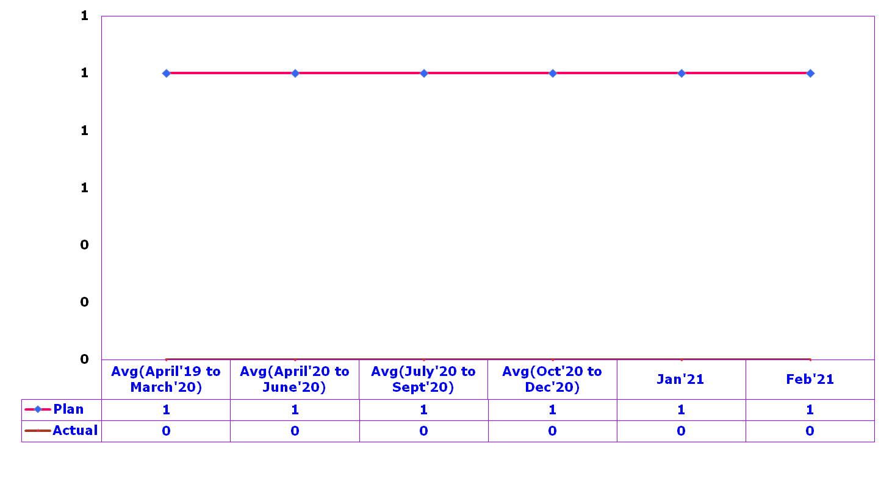
Department –PREPARATION
Department | ENGINEERING | Process Measure | Equipment maintenance
Section | Apex tuber | Unit of Measurement | NO OF OCCASSIONS
Process Model Ref | S6
Occasions (Nos.)

Slide 4
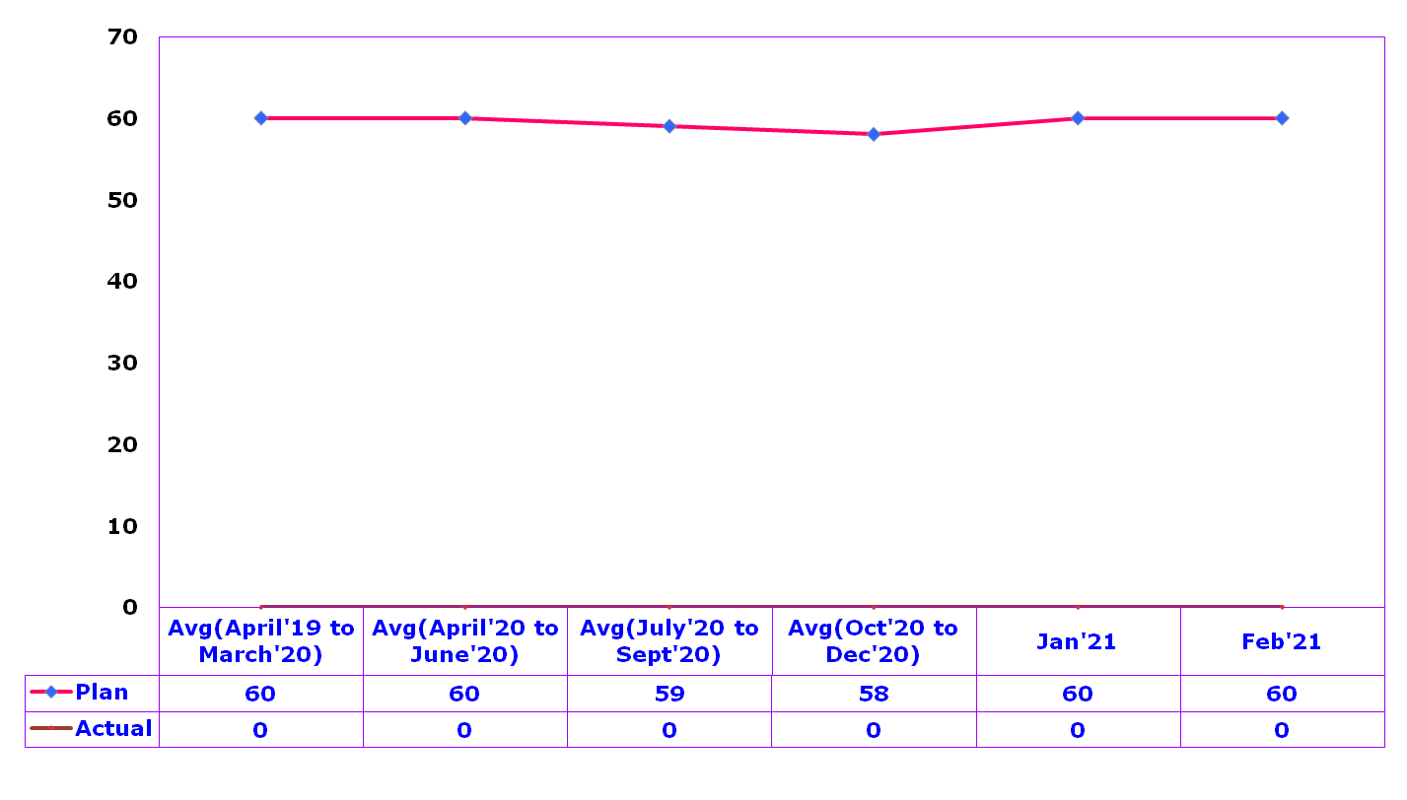
Department –PREPARATION
Department | ENGINEERING | Process Measure | Equipment maintenance
Section | Apex tuber | Unit of Measurement | Time (Minutes)
Process Model Ref | S6
Time (Minutes)

Slide 5
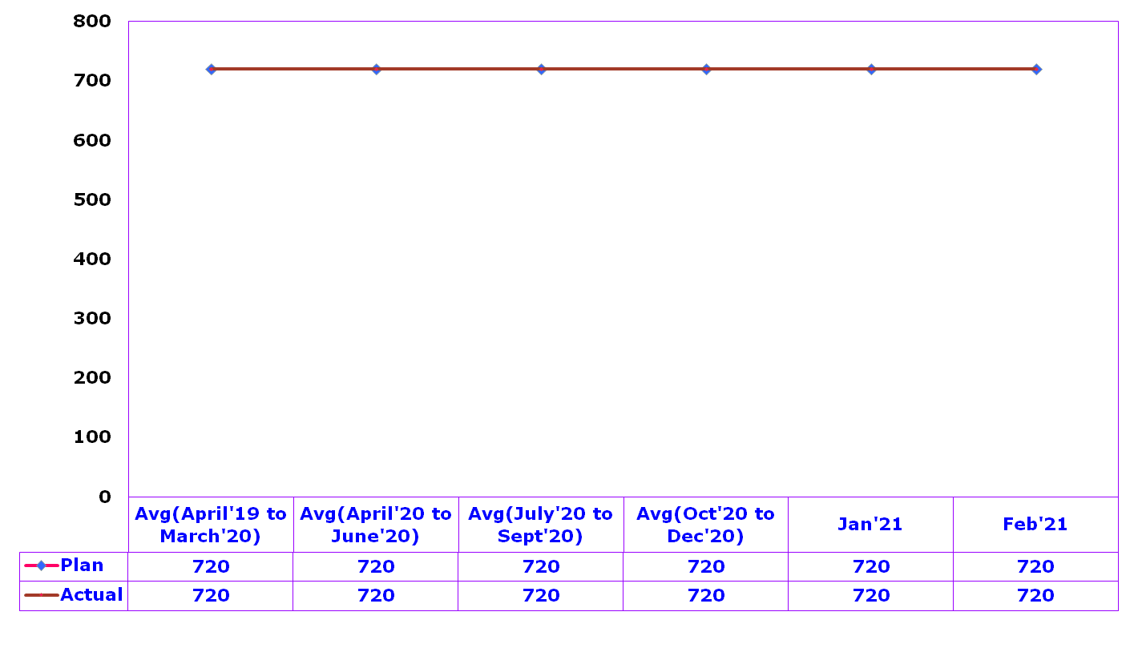
Department –PREPARATION (MTBF)
Department | ENGINEERING | Process Measure | MTBF
Section | Apex tuber | Unit of Measurement | NO OF Hours
Process Model Ref | S6
MTBF (Hours)

Slide 6
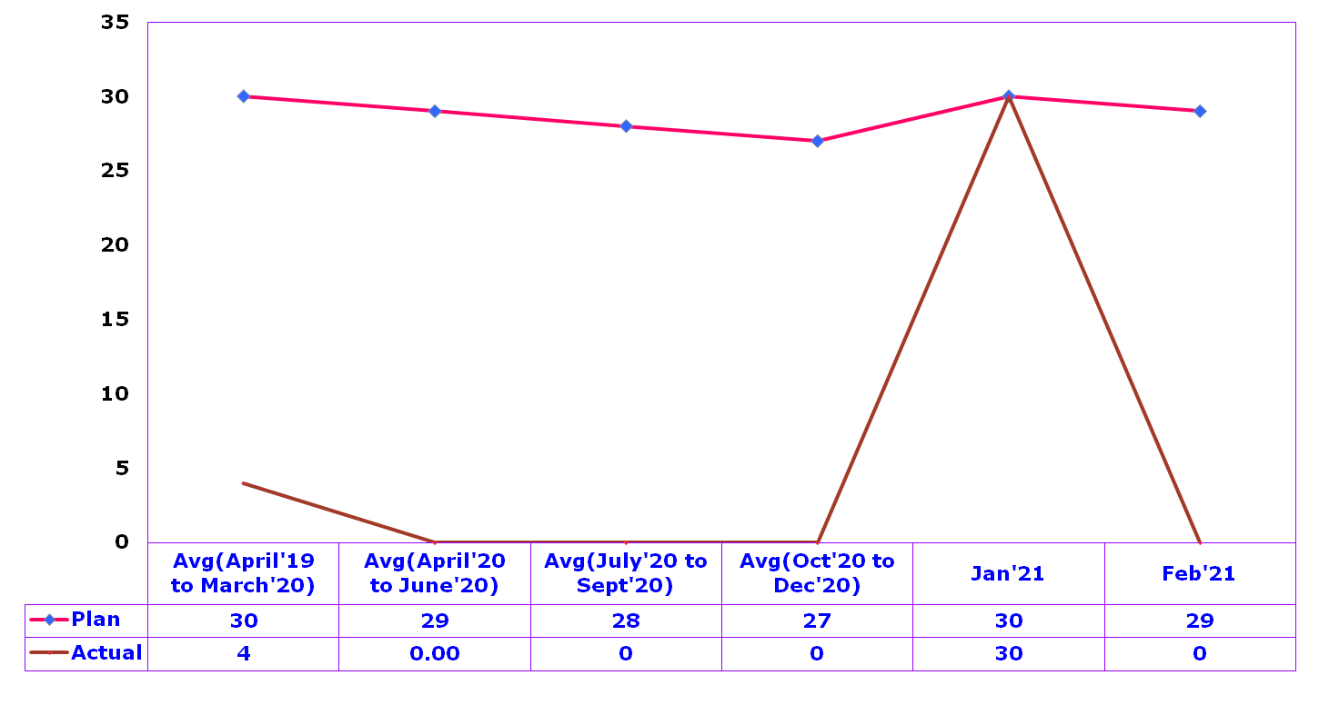
Department – PREPARATION(MTTR)
Department | ENGINEERING | Process Measure | MTTR
Section | Apex tuber | Unit of Measurement | NO OF Minutes
Process Model Ref | S6
MTTR (Minutes)

Slide 7
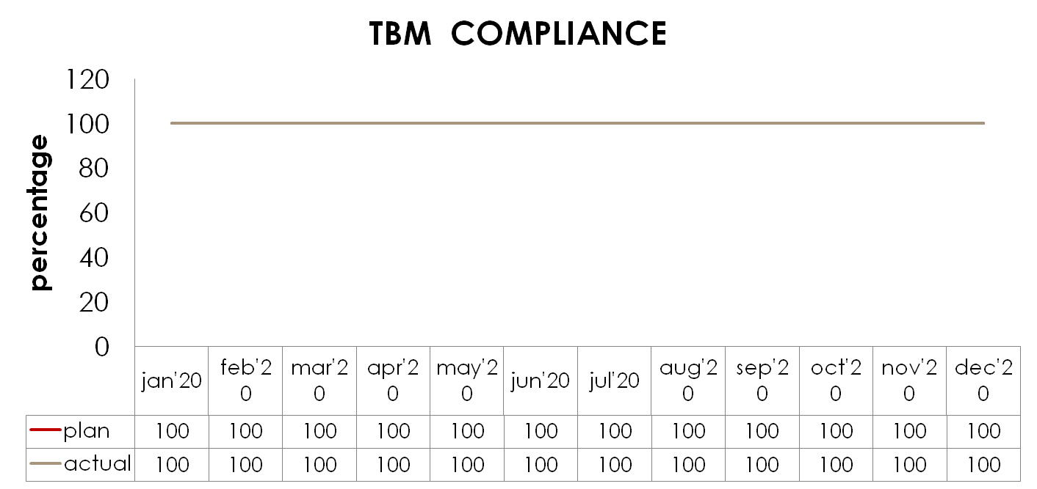
Department | ENGG | Process Measure | TBM-COMPLIANCE
Section | Apex Tuber | Unit of Measurement | PERCENTAGE
Process Model Ref | S6

Slide 8


